Slide 1


Slide 2
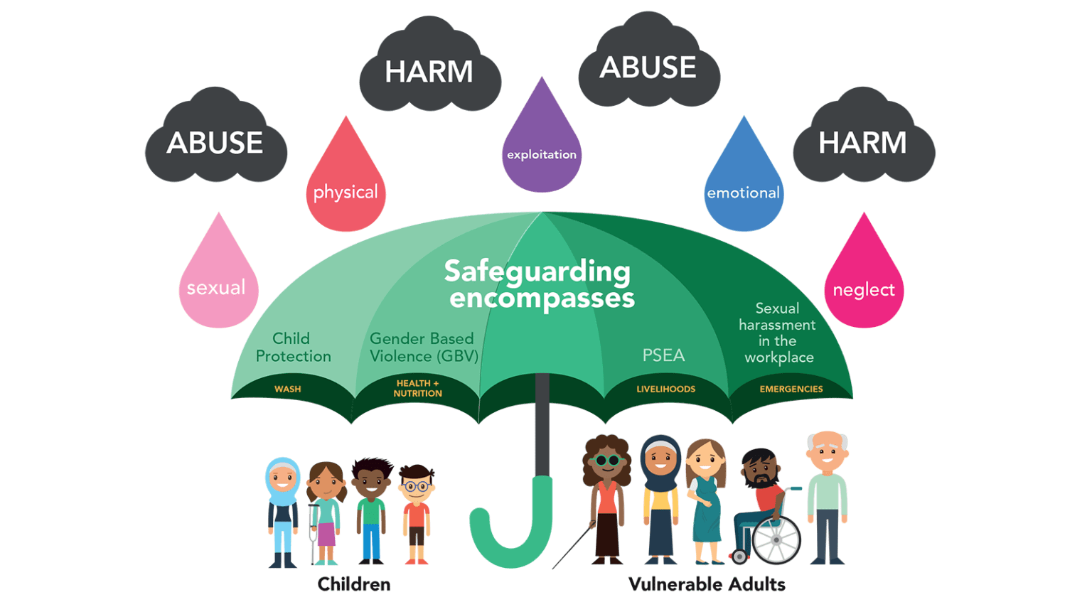
What does Safeguarding mean?
Safeguarding means protecting a person’s health, wellbeing, and human rights, enabling them to live free from harm, abuse, and neglect.

Slide 3



Remember Safeguarding Is…….

Slide 4
Employer's Duty of Care
Legal obligation - Under the Safeguarding Vulnerable Groups Act (2006)
Ensuring apprentices are working in a safe environment.
Duty to report any concerns of abuse or neglect to relevant
authorities.
Supporting apprentices in raising concerns without fear of reprisal.

Slide 5
Identifying Abuse
Neglect
Persistent failure to meet a child's basic physical and/or psychological needs, likely to result in the serious impairment of the child’s health or development.
Sexual Abuse
Forcing or enticing a child or young person to take part in sexual activities, whether or not the child is aware of what is happening.
Neglect
Sexual Abuse
Emotional Abuse
The persistent emotional maltreatment of a child such as to cause severe and adverse effects on the child'
Physical Abuse
Abuse which may involve hitting, shaking, throwing, poisoning, burning or scalding, drowning, suffocating or otherwise causing physical harm to a child.
Emotional Abuse
Physical Abuse
“A person’s a person, no matter how small”
Dr Seuss

Slide 6
Responding to Safeguarding Concerns
Remain calm and non-judgmental.
Listen actively without making promises you can't keep.
Record the details of the concern in a secure manner.
Inform the relevant authorities, such as HR,
designated safeguarding officer, or external agencies.
Do not attempt to investigate the concern yourself - let professionals
handle it.

Slide 7
Supporting Mental Health in Apprentices
Apprentices may face mental health challenges due to work stress,
personal issues, or transition to adulthood.
Encourage open communication and create a safe, supportive environment.
Offer access to mental health support services, such as Employee
Assistance Programs.
Be aware of signs of mental health struggles (e.g: withdrawal, low mood
and exhaustion.)

Slide 8
How to contact the College Safeguarding Team
Tel: 01274 088999
Email: safeguarding@bradfordcollege.ac.uk
In-Person:
Main Campus: David Hockney Building
Location: Second Floor, David Hockney Building (DHB) ​
Opening times: Monday to Friday 8.30am to 4.30pm ​
Trinity Green Campus​
Location: Student Service Offices, Resource Centre, Ground Floor ​
Opening times: Monday to Friday 8.30am to 4.30pm

